Slide 1
Smart Traveller with Visual Translator for OCR and Face Recognition
LYU0203 FYP

Slide 2
Outline
Introduction
  Face Detection
  Face Recognition
Methods for Face Detection
Methods for Face Recognition
Conclusion
Q&A session

Slide 3
Introduction
Our FYP project consists of two parts – Korean OCR and Face Recognition
Today, we present the issues of face recognition only

Slide 4
Introduction (cont’)
Framework of Face recognition
Face Detection
Find
Face Region
Facial Feature
Face Recognition
Identify the person
Input Image
Face Region/
position
of facial feature
Person’s name

Slide 5
Methods for Face Detection
Color-based model
Neural Network
Coarse to fine method
Gabor wavelet

Slide 6
Color Based Model
We can find the face region by color.
YUV or YIQ color model is usually used in color classification.
Usually face color is within a small space in color model.
Mathematical equations are used to represent face color in these color model.

Slide 7
Color Model (cont’)
Advantages:
  Easy to implement
  Fast
Disadvantages:
  Not reliable (especially photo taken by camera in PPC)
  Affected by complex background

Slide 8
Neural Network
It is a pure pattern recognition. (no color information needed)
In principal, the popular back-propagation neural network can be trained to detect face images directly.
The intensity of the image is the input of the neural network.

Slide 9
Neural Network (cont’)
The procedure is similar to the algorithm proposed by CMU
Manually collect large amount of face image (about 1000)
The image is scaled to 20x20 pixels.
Create non-face image with random pixel intensities.
Train the neural network to produce 1 for face image and -1 for non-face image

Slide 10
Neural Network (cont’)
Advantages:
  High accuracy (detection rate ~90%)
  Not difficult to implement
Disadvantages:
  Difficult to train
  Slow

Slide 11
Coarse-to-fine method
Hierarchical architecture is used to find the facial feature.
Position, scale and orientation are partitioned into a sequence of nested partitions with different constraint.
A set of edge detectors is used to find the range of position, scale and orientation.

Slide 12
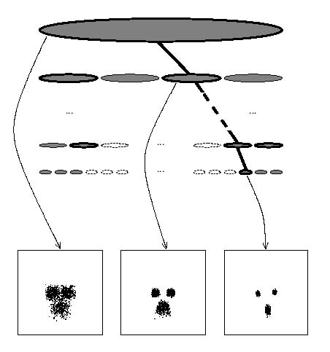
Coarse-to-fine method (cont’)
Partition with loose constrains
Partition with strict constrains

Slide 13
Coarse-to-fine method (cont’)
Advantages:
  Fast
  Acceptable accuracy with simple background
Disadvantages:
  High resolution image is required
  Fail to find face with blurred image

Slide 14
Gabor Wavelet
A simple model for the responses of simple cells in the primary visual cortex.
It extracts edge and shape information.
It can represent face image in a very compact way.

Slide 15

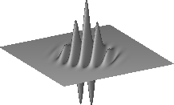
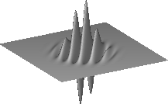
Gabor Wavelet (cont’)
Real Part
Imaginary Part

Slide 16
Gabor Wavelet (cont’)
Advantages:
  Fast
  Acceptable accuracy
  Small training set
Disadvantages:
  Affected by complex background
  Slightly rotation invariance

Slide 17
Methods for Face Recognition
EigenFace
Template-based Matching
Gabor wavelet

Slide 18
EigenFace
EigenFace is a common method for face recognition
Principal Component Analysis (PCA) is used
  Find the covariance of the training images
  Compute the eigenvectors of the covariance

Slide 19
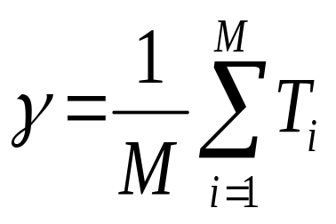
EigenFace (cont’)
Procedure
  Scale the face images into 20x20 pixels size
  Each face image is a 400-dimensional vector
  Find the average face by
  where M is the number of the face images and T is the face images vector

Slide 20
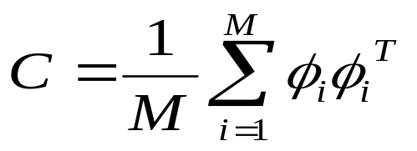
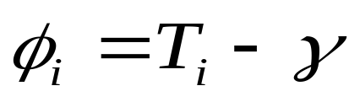
EigenFace (cont’)
Procedure (cont’)
  Find the Covariance Matrix by
  where
  Compute the eigenvectors and eigenvalues of C

Slide 21
EigenFace (cont’)
Procedure (cont’)
  The M’ significant eigenvectors are chosen as those with the largest corresponding eigenvalues
  Project all the face images into these eigenvectors and form the feature vectors of each face image

Slide 22
EigenFace (cont’)
Procedure (cont’)
  For recognition
    Project the test face image to the eigenvectors
    Find the difference (Euclidean Distance) between the projected vector and each face image feature vector
    Choose the minimum one as the result or reject all if the differences are greater than a threshold

Slide 23
Eigenface (cont’)
Advantages
  Fast on Recognition
  Easy to implement
Disadvantages
  Finding the eigenvectors and eigenvalues are time consuming on PPC
  The size and location of each face image must remain similar

Slide 24
Template-based Method
The most direct method used for face recognition is the matching between the test images and a set of training images based on measuring the correlation.
The similarity is obtained by normalize cross correlation.

Slide 25
Template-based Method (cont’)
Advantages:
  Easy to implement
Disadvantages:
  Highly sensitive to illumination
  Not reliable
  Expensive computation in order to achieve scale invariance.

Slide 26
Gabor Wavelet
Gabor wavelet can be used to extract the information of face.
Matching with the feature extracted by Gabor wavelet
Advantages and Disadvantages are the same as that of Face Detection.

Slide 27
Conclusion
Limitations need to be considered
  Computational power of PPC
  Time constraint of the project
Methods used in our project
  Gabor wavelet is used in face detection
  EigenFace is used in face recognition
Both are fast and not difficult to implement

Slide 28
Q&A Session

